Slide 1
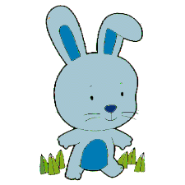
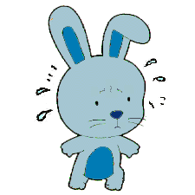
This is Bunny.
Bunny is worried because tomorrow s/he has to give show-and-tell.
Show-and-tell makes bunny worried.

Slide 2
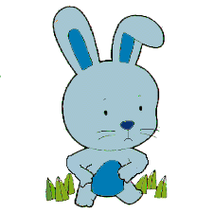

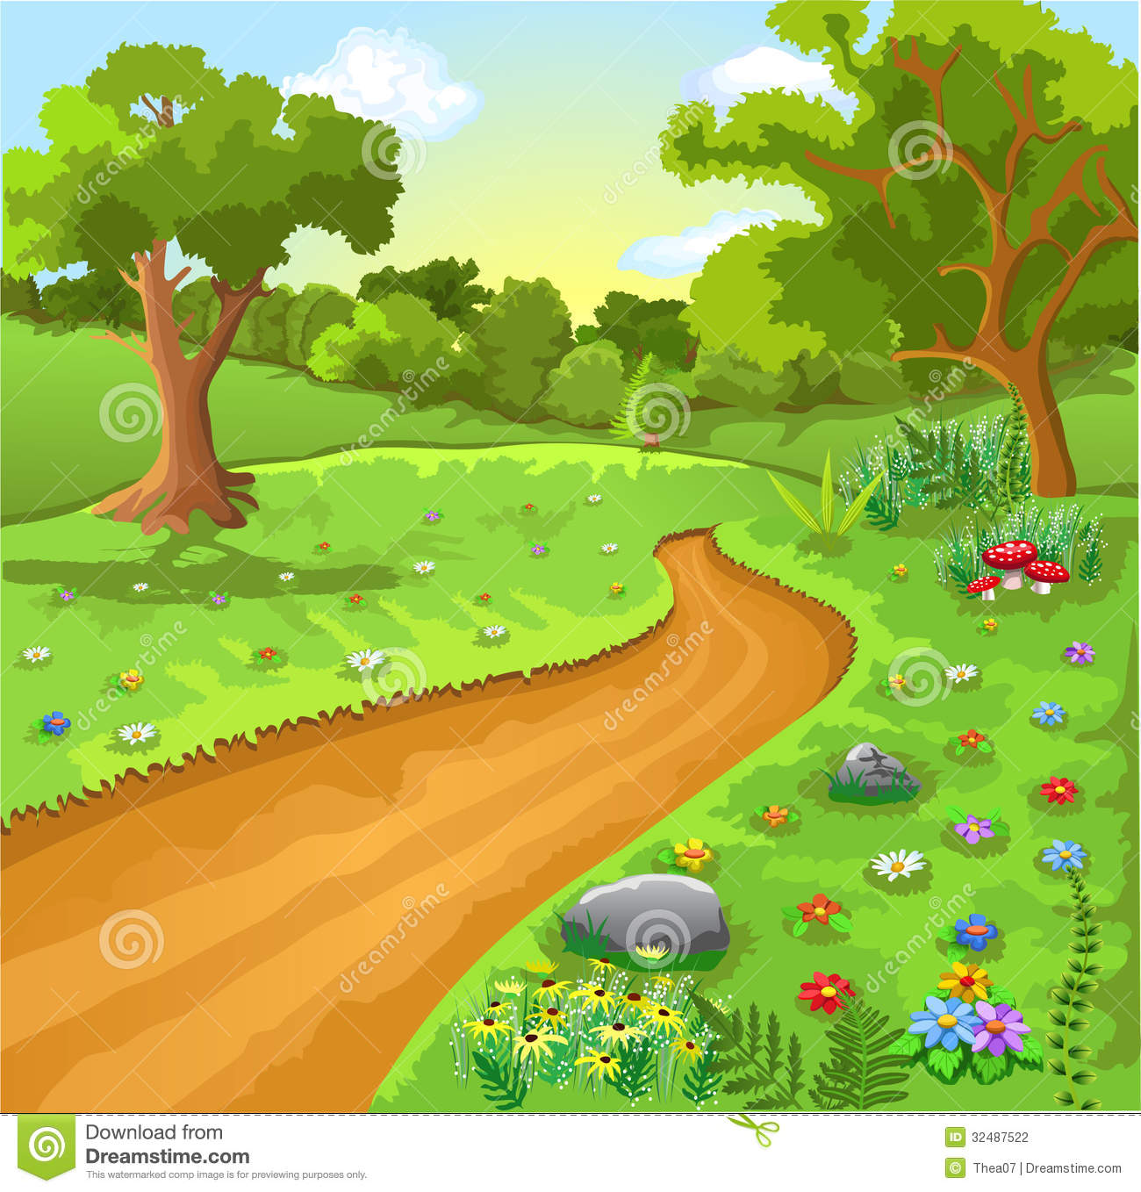
In the morning, Bunny thinks about show-and-tell, and so Bunny feels worried. Bunny eats some cheese. Bunny goes out for a walk.
Bunny has a tummy ache.
Otherwise, Bunny feels good.
Notes:
Hmm, I wonder why bunny has a tummy ache, let’s keep reading to find out.

Slide 3
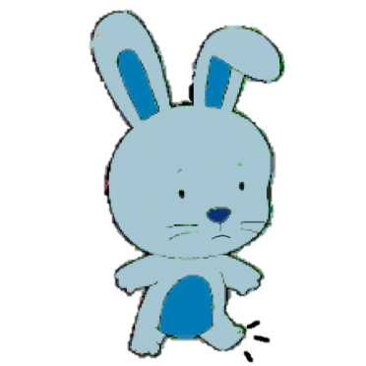


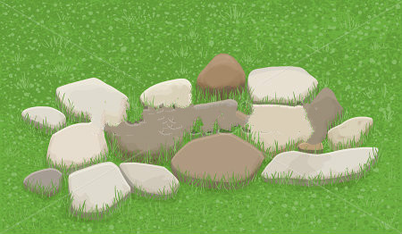
In the afternoon, Bunny eats some tofu. Bunny ties her/his shoes very tight. Bunny runs very fast on the hard rocks.
Bunny has sore foot.
Otherwise, Bunny feels good.
Notes:
Hmm, I wonder why bunny has a sore foot; let’s keep reading to find out.

Slide 4
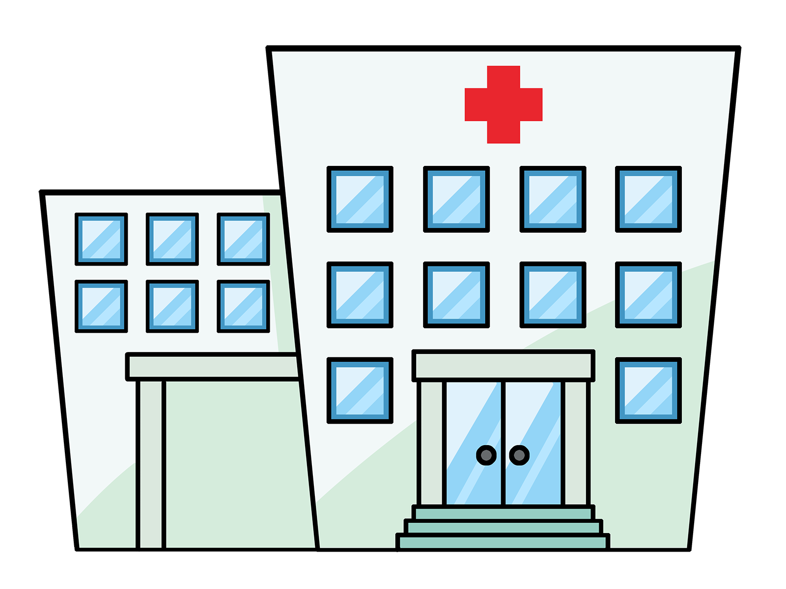

Later in the afternoon, Bunny went to the doctor’s office to find out why s/he has a tummy ache and sore foot.

Slide 5
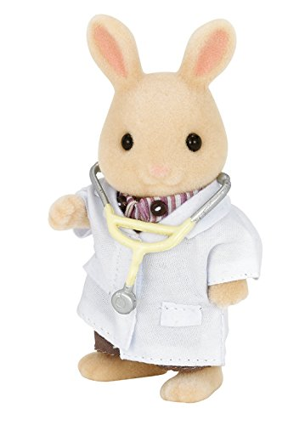
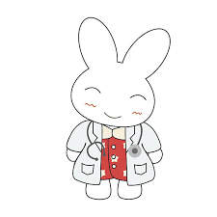


Bunny told the tummy doctor all about her/his day and how in the morning s/he felt worried and ate some cheese.
The tummy doctor looked at Bunny’s tummy and says s/he will call Bunny tonight with the reason why Bunny has a tummy ache.
Bunny told the foot doctor all about her/his day and how in the afternoon (s)he tied his/her shoes very tight & ran very fast on the hard rock.
The foot doctor looked at Bunny’s foot and says s/he will send Bunny an email message to tell him/her why s/he has sore foot.

Slide 6

In the evening, Bunny comes home from her doctor’s visits.
(S)he finds that there is a phone message from the tummy doctor and an email message from the foot doctor !
Here’s where we get to have your help with the story!
You can find out why Bunny has a tummy ache from the phone message.
Or, instead, you can find out why Bunny has sore foot from the email message.
If you want to find out why Bunny has tummy ache please click this; if you want to find out why Bunny has sore foot please click that.

Slide 7
Phone message:
Bunny has a tummy ache because she/he was worrying about show-and-tell.
Notes:
Bunny has a tummy ache because she/he was worrying about show-and-tell.

Slide 8
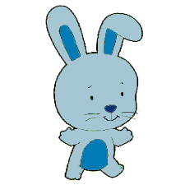
The next day, in the morning, Bunny ran on the grass. Bunny also gave show-and-tell. S/he did very well and everyone clapped! Bunny felt great.
The End
Hurray for Bunny!

Slide 9
Email message:
Bunny has sore foot because she/he was running on the hard rock.
Notes:
Bunny has sore foot because she/he was running on the hard rock.

Slide 10
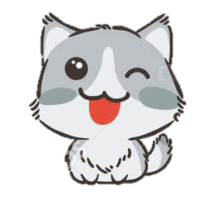
This is Kitty.

Slide 11

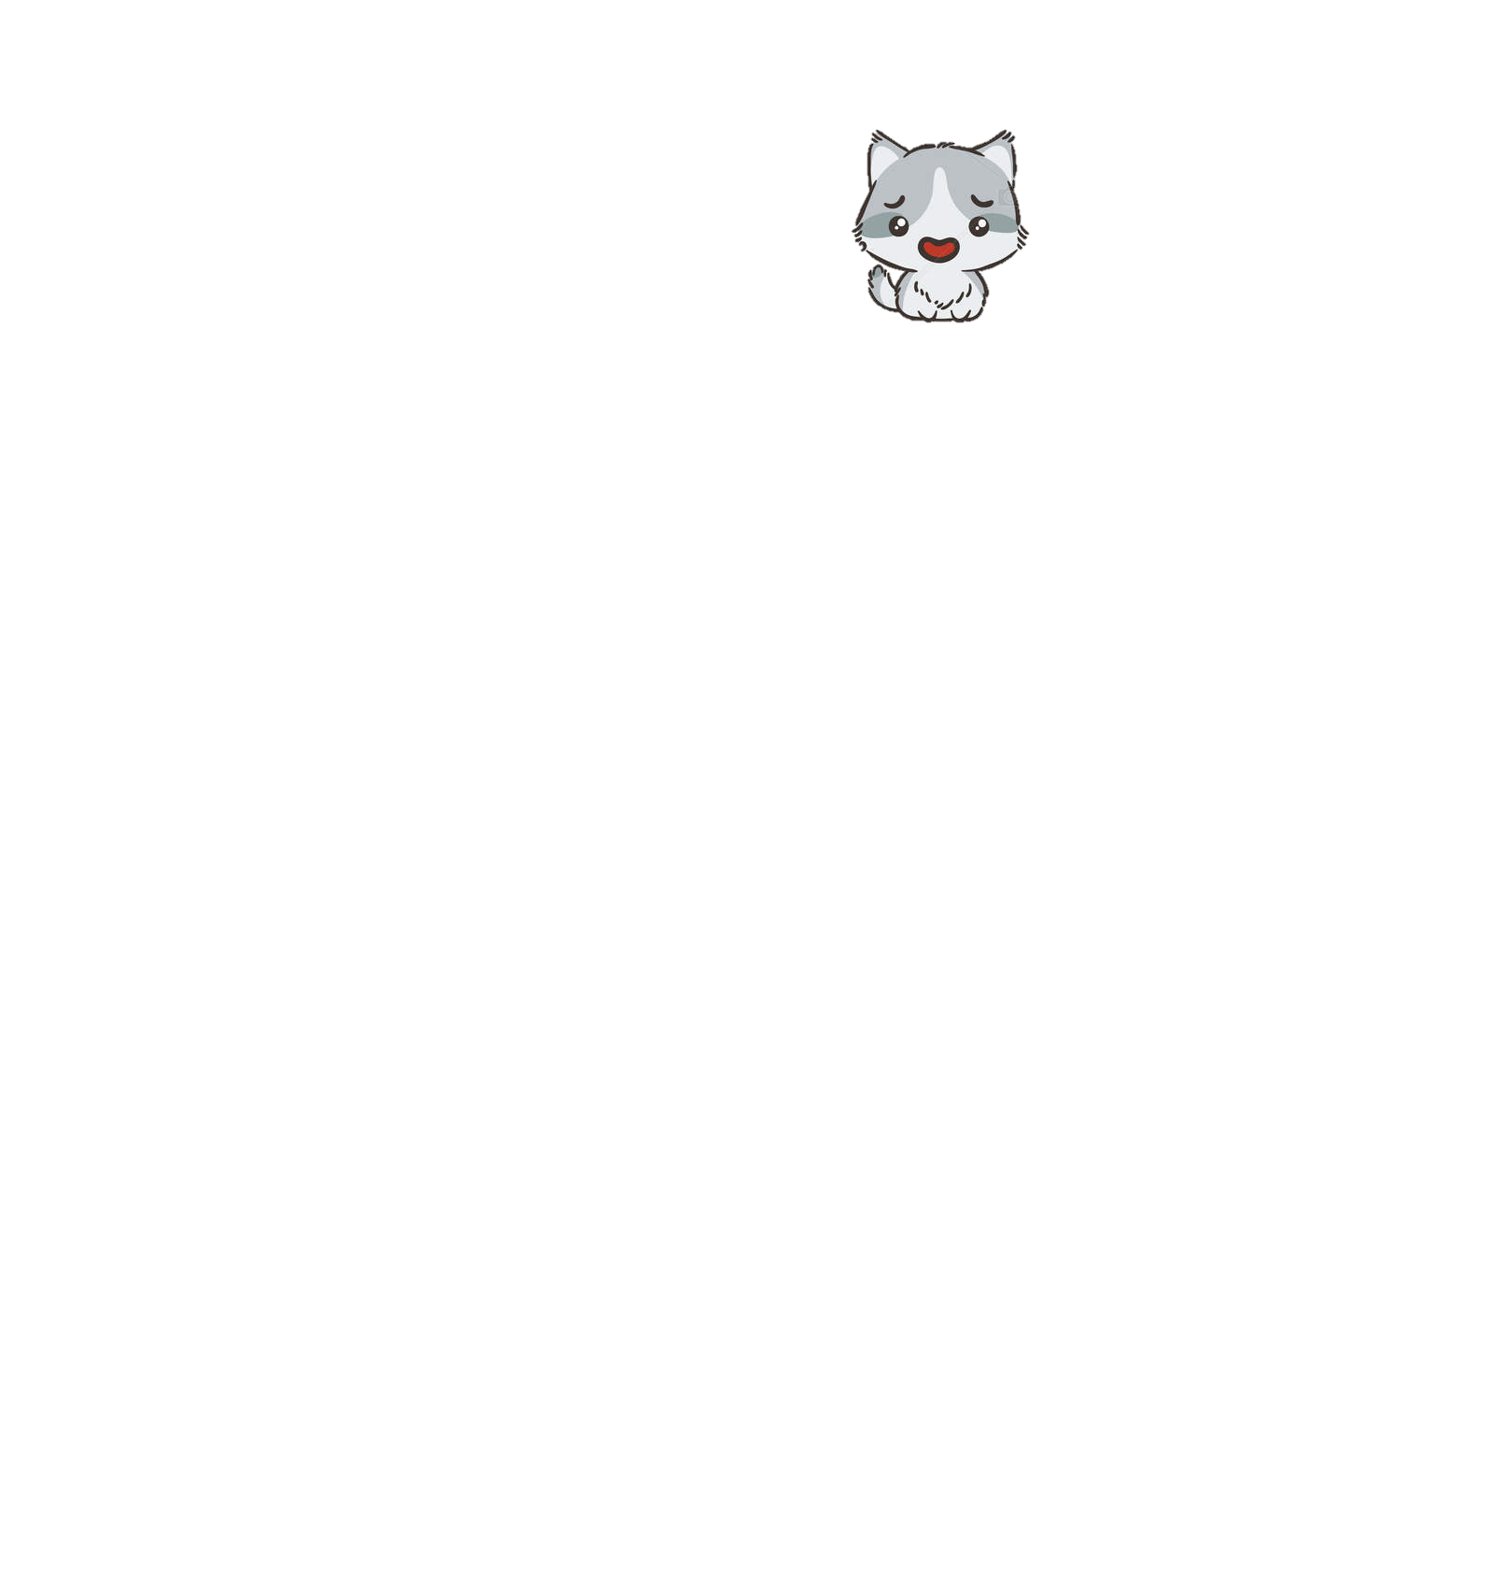

Kitty bumped on the cabinet.
Kitty ate ice cream really fast.
Kitty has a headache.

Slide 12
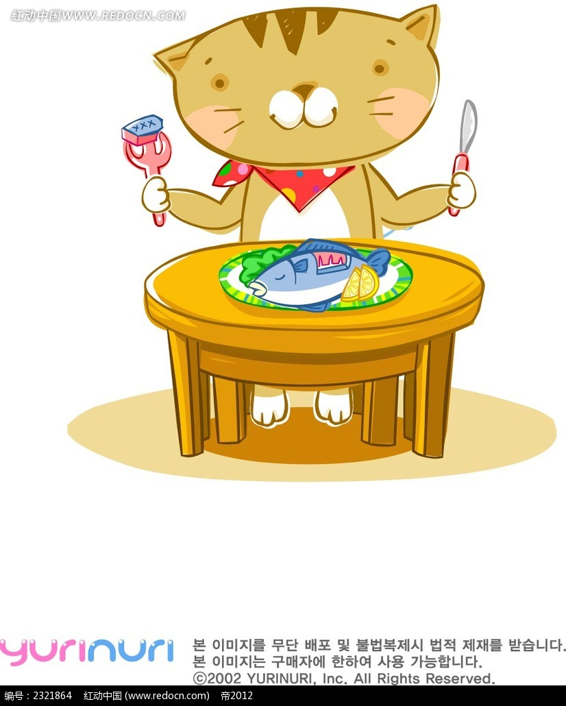
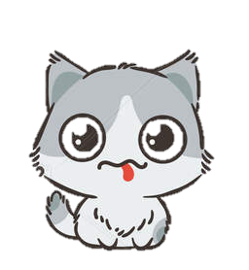
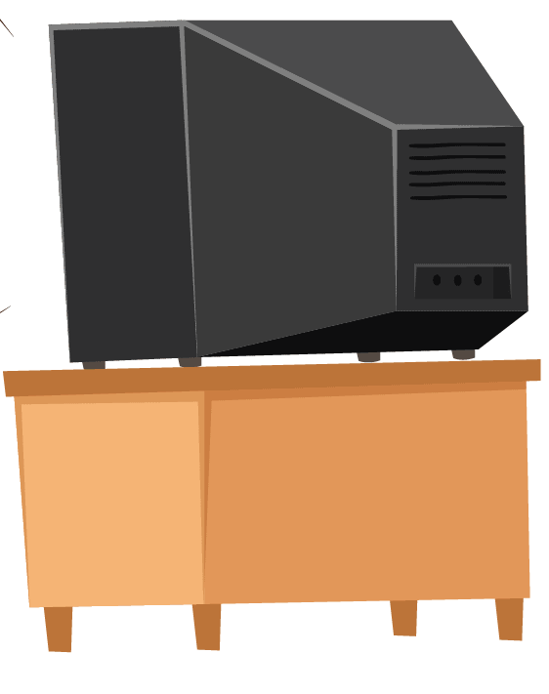
Kitty ate some fish. Kitty watched some TV. Kitty has a stomach ache.

Slide 13
Do you want to find out why Kitty has a stomach ache, or why Kitty has a headache?

Slide 14
Kitty has a headache because s/he ate ice cream too fast!

Slide 15
Kitty took some rest, and now s/he feels all better!
Yay for Kitty!

Slide 16
Kitty has a stomach ache because s/he ate too much fish!

